Slide 1
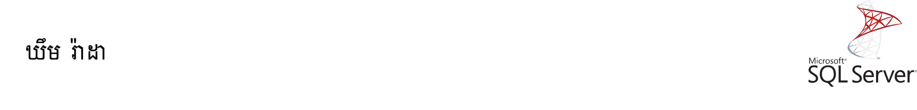
Table-valued Functions
A table-valued function is a user-defined function that returns data of a table type. The return type of a table-valued function is a table, therefore, you can use the table-valued function just like you would use a table.

Slide 2
Creating a table-valued function:
The following statement example creates a table-valued function that returns a list of products including product name, model year and the list price for a specific model year:

Slide 3
CREATE FUNCTION udfProductInYear (@model_year INT)
RETURNS TABLE
AS
RETURN
SELECT product_name, model_year, list_price
FROM production.products
WHERE model_year = @model_year;

Slide 4
The syntax is similar to the one that creates a user-defined function.
The RETURNS TABLE specifies that the function will return a table. As you can see, there is no BEGIN...END statement. The statement simply queries data from the production.products table.

Slide 5
The udfProductInYear function accepts one parameter named @model_year of type INT. It returns the products whose model years equal @model_year parameter.

Slide 6
Once the table-valued function is created, you can find it under Programmability > Functions > Table-valued Functions as shown in the following picture:

Slide 7
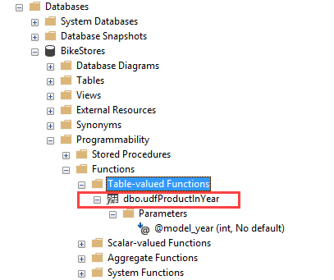

Slide 8
Executing a table-valued function:
To execute a table-valued function, you use it in the FROM clause of the SELECT statement:
SELECT *
FROM udfProductInYear(2017);

Slide 9
Modifying a table-valued function:
To modify a table-valued function, you use the ALTER instead of CREATE keyword. The rest of the script is the same.

Slide 10
For example, the following statement modifies the udfProductInYear by changing the existing parameter and adding one more parameter:

Slide 11
ALTER FUNCTION udfProductInYear (@start_year INT,
@end_year INT)
RETURNS TABLE
AS
RETURN
SELECT product_name, model_year, list_price
FROM production.products
WHERE
model_year BETWEEN @start_year AND @end_year

Slide 12
The following statement calls the udfProductInYear function to get the products whose model years are between 2017 and 2018:

Slide 13
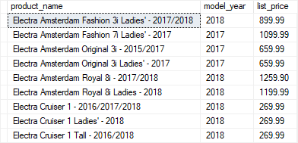
SELECT product_name, model_year, list_price
FROM
udfProductInYear(2017,2018)
ORDER BY
product_name;

Slide 14
Multi-statement table-valued functions (MSTVF):
A multi-statement table-valued function or MSTVF is a table-valued function that returns the result of multiple statements.

Slide 15
The multi-statement-table-valued function is very useful because you can execute multiple queries within the function and aggregate results into the returned table.

Slide 16
To define a multi-statement table-valued function, you use a table variable as the return value. Inside the function, you execute one or more queries and insert data into this table variable.

Slide 17
The following udfContacts() function combines staffs and customers into a single contact list:

Slide 18
CREATE FUNCTION udfContacts()
RETURNS @contacts TABLE ( first_name VARCHAR(50),
last_name VARCHAR(50), email VARCHAR(255),
phone VARCHAR(25), contact_type VARCHAR(20) )
AS
BEGIN
INSERT INTO @contacts
SELECT first_name, last_name, email, phone,'Staff '

Slide 19
FROM sales.staffs;
INSERT INTO @contacts
SELECT first_name,last_name, email,phone, 'Customer'
FROM
sales.customers;
RETURN;
END;

Slide 20
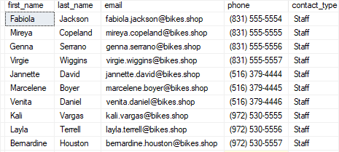
The following statement illustrates how to execute a multi-statement table-valued function udfContacts:
SELECT *
FROM udfContacts();

Slide 21
When to use table-valued functions:
We typically use table-valued functions as parameterized views. In comparison with stored procedures, the table-valued functions are more flexible because we can use them wherever tables are used.

Slide 22
Thanks

Slide 23
Table-valued Functions

